Slide 1
Text Analytics, Sentiment Analysis & Neural Networks
Presented by:
Avinash yekkala
Pruthvi raj
Neola pinto
Naini shah

Slide 2
Web Scraping & Text Analysis
Web Scraping : extracting information from world wide web to convert it into a format suitable for text analysis
Text Analysis Is about deriving high quality information from text through processing, application of patterns and trends
Dataset/product used for our project is from Amazon. (Book – Girl on the Train)

Slide 3
Analysis on Reviews gathered by the Book – Girl on the Train
Steps involved :
Web Scraping
Lexicon Analysis
- Tokenizing
- Data cleansing
- Removal of stop words
- Stem words
- Group words as Positive or Negative
Sentiment Analysis
Final call on positive/negative review

Slide 4
What does our code do?
1. Packages used : Rvest, Plyr, SnowballC, NLP, Tm, RTextTools, Rstem
2. Initially we scrape the data from the amazon website and transformed it into Corpus
3. Tokenize the data and clean it to remove stop words, spaces, punctuations etc.
4. Fetch the positive & negative words from different files
5. Perform stemming on dataset
6. Calculate the frequency of the words occurring

Slide 5
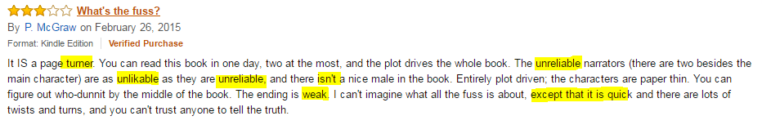
Sentiment Analysis:
Example:

Slide 6
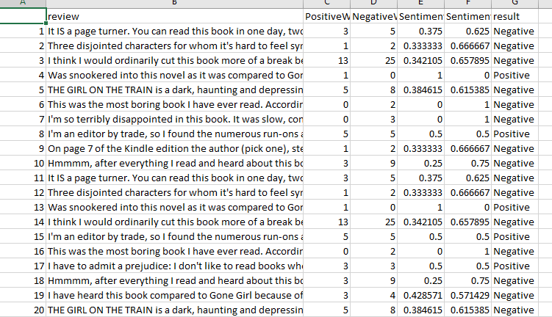
Sentiment Analysis continued:

Slide 7
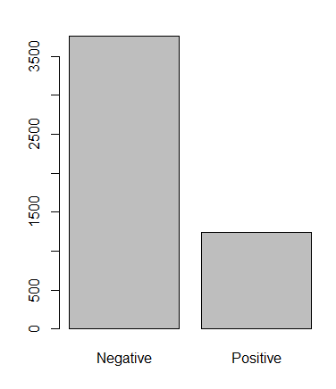


Positive vs. Negative Reviews
Hence, conclusion –
The book has received most number of
negative reviews

Slide 8
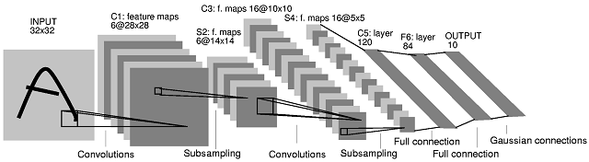
Convolutional Neural Networks:
In machine learning, a convolutional neural network is a type of feed-forward neural network in which the connectivity pattern between its neurons is inspired by the organization of the animal visual cortex where it contains multiple layers of receptive fields.
Link : http://scs.ryerson.ca/~aharley/vis/conv/flat.html

Slide 9
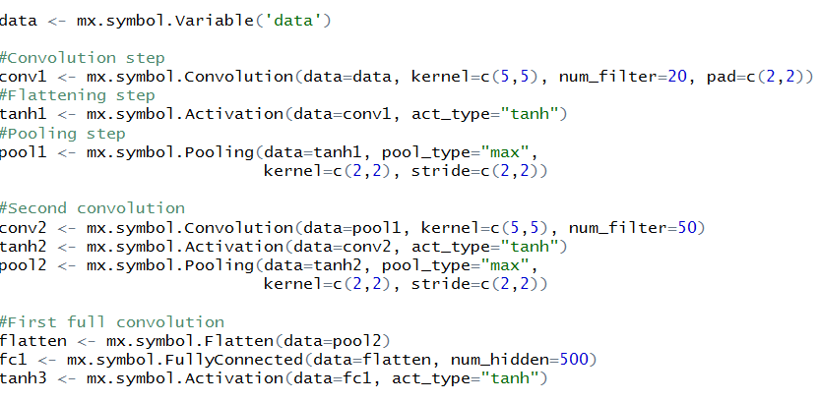
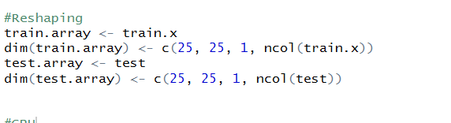
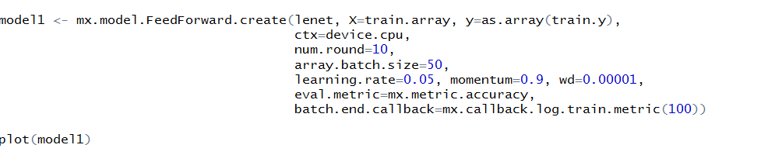
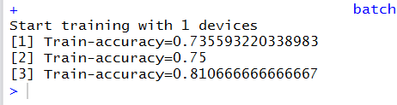
CNN Code snippet:

Slide 10
CNN Performance Measures:
Accuracy | Kappa value | P-Value
81.06 | 0.6 | 2.2e-16

Slide 11
Deep Belief Networks:
Deep belief network (DBN) is a generative graphical model, or alternatively a type of deep neural network.
Consists multiple layers of "hidden units", with connections between the layers but not between units within each layer.
DBNs can be viewed as a composition of simple, unsupervised networks where each sub-network's hidden layer serves as the visible layer for the next

Slide 12
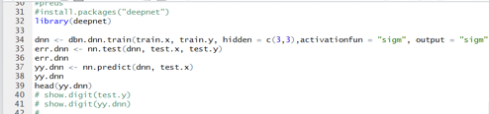
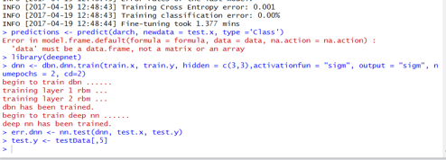
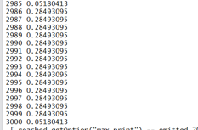
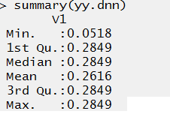
Deep Belief Network:
CODE:
DBN Model
Predictions and summary of predictions

Slide 13

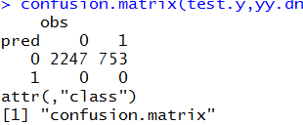
Result:
RESULT:
Error rate
Accuracy
Confusion Matrix

Slide 14
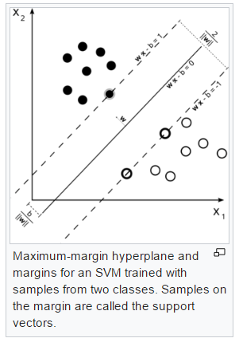
Support Vector Machines:
In machine learning, support vector machines (SVMs, also support vector networks) are supervised learning models with associated learning algorithms that analyze data used for classification and regression analysis.
An SVM model is a representation of the examples as points in space, mapped so that the examples of the separate categories are divided by a clear gap that is as wide as possible. New examples are then mapped into that same space and predicted to belong to a category based on which side of the gap they fall.

Slide 15


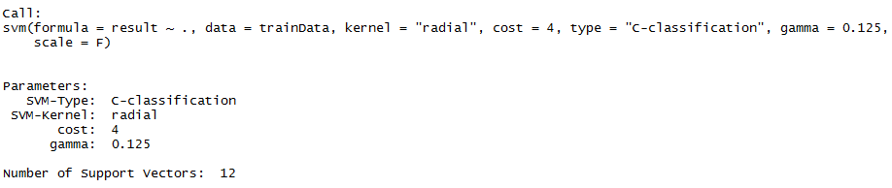
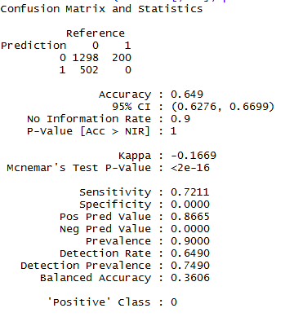
Code:

Slide 16

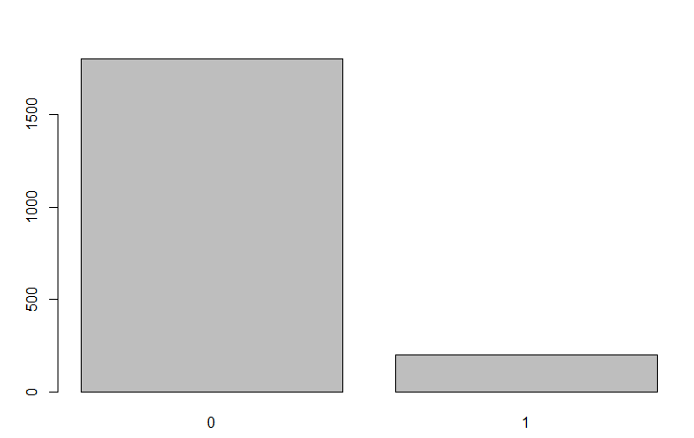
Result:

Slide 17
Conclusion:
CNN | DBN | SVM
81.06 | 74.9 | 64.9
As per our analysis CNN model works best for us with the highest accuracy

Slide 18
Thank You

